Slide 1
Lecture 2 Introduction to serological data analyses in R
May 21, 2025
Seroanalytics Training Blantyre, Malawi

Slide 2
Lecture outline
What is R and RStudio?
What is a R script and R markdown?
What is a ‘wide’ versus ‘long’ data frame?
What are the different types of data frames used in serology?
Review the Intro to R.Rmd

Slide 3
What is R?
R is a programming language for statistical computing and graphics.
Open-source and maintained by the R Core Team.
Used for data analysis, modeling, visualization, and more.
Runs in a command-line interface or through scripts.

Slide 4
What is RStudio?
RStudio is an integrated development environment (IDE) for R.
Provides a user-friendly interface for writing and running R code.
Includes script editor, console, environment viewer, and plot pane.
Helps manage workflows and boosts productivity.

Slide 5
Key Differences Between R and RStudio
R is the language; RStudio is an interface to use R.
R can be used alone; RStudio requires R to run.
R handles the computation; RStudio provides tools to interact with R.
RStudio enhances usability with projects, tabs, and debugging tools.

Slide 6



Slide 7
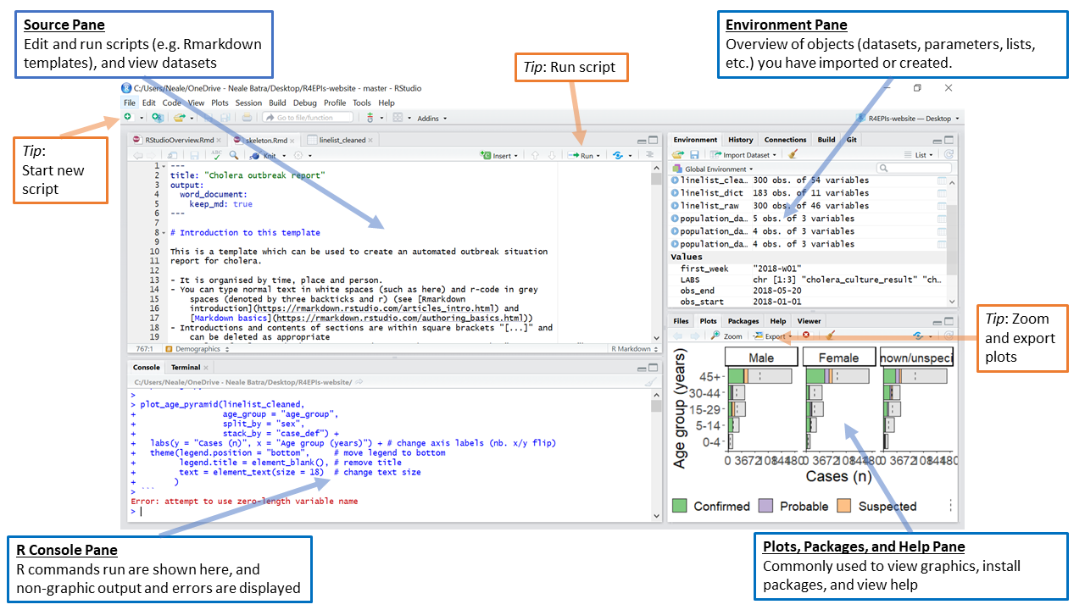
RStudio
Notes:
The Source Pane This pane, by default in the upper-left, is a space to edit, run, and save your scripts. Scripts contain the commands you want to run. This pane can also display datasets (data frames) for viewing.
The R Console Pane
The R Console, by default the left or lower-left pane in R Studio, is the home of the R “engine”. This is where the commands are actually run and non-graphic outputs and error/warning messages appear. You can directly enter and run commands in the R Console but realize that these commands are not saved as they are when running commands from a script.
The Environment Pane This panen is most often used to see brief summaries of objects in the R Environment in the current session. These objects could include imported, modified, or created datasets, parameters you have defined, or vectors or lists you have defined during analysis. You can click on the arrow next to a data frame name to see its variables. This pane also contains History where you can see commands that you executed previously. It also has a “Tutorial” tab where you can complete interactive R tutorials if you have the learnr package installed. It also has a “Connections” pane for external connections and can have a “Git” pane if you choose to interface with Github.
Plots, Viewer, Packages, and Help Pane Typically plot graphics will display in the Plot pane. Interactive or HTML outputs will display in the Viewer pane. The Help pane can display documentation and help files. The Files pane is a browser which can be used to open or delete files and to set your working directory. The Packages pane allows you to see, install, update, delete, load/unload R packages, and see which version of the package you have.

Slide 8
What is an R Script?
A plain text file containing R code (.R extension).
Used for writing, running, and saving R commands.
Best for quick scripting, data analysis, and model building.
Cannot produce formatted output documents directly.

Slide 9
What is an R Markdown File?
A document combining R code with text and formatting (.Rmd extension).
Supports code chunks, inline results, and narrative text.
Can generate reports in PDF, Word, or HTML using knitr and pandoc.
Great for reproducible research and reporting.

Slide 10
Key Differences: R Script vs R Markdown
R Script runs code; R Markdown runs and documents code.
R Script code only; R Markdown code + formatted text.
R Markdown supports knitting into readable documents with plots and tables.
R Scripts are best for development; R Markdown is best for communication.

Slide 11
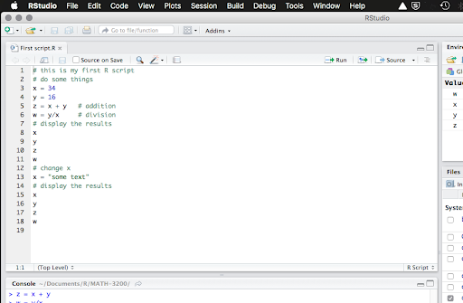
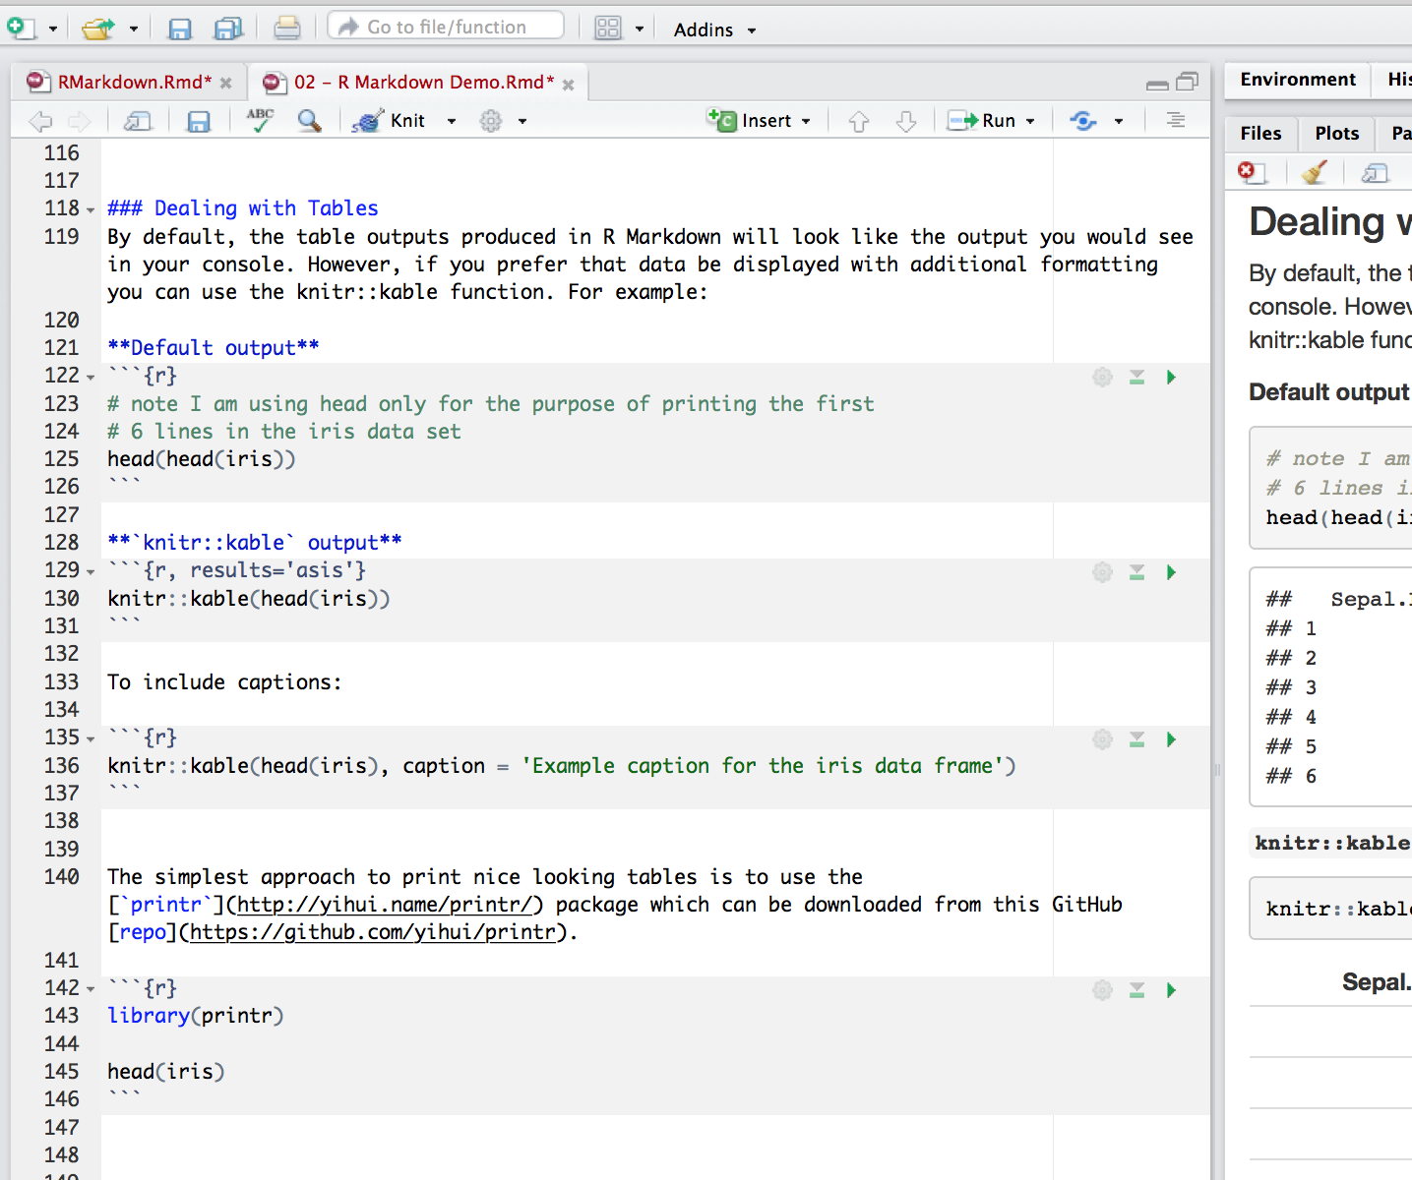
Visual Comparison: R Script vs R Markdown
R Script View
(code-only interface)
R Markdown View
(code + formatted output)

Slide 12
Wide vs. Long Data Frames in R
Wide Format
Each variable has its own column (e.g., one column per time point)
Common in spreadsheet-style data or for visualization (e.g., plots)
Easier to read but harder to manipulate in some R functions
Long Format
Each observation is a row; variables like 'time' and 'value' are separate columns
Preferred for some functions (e.g., ggplot2, dplyr, tidyr)
Easier for grouped operations and reshaping

Slide 13
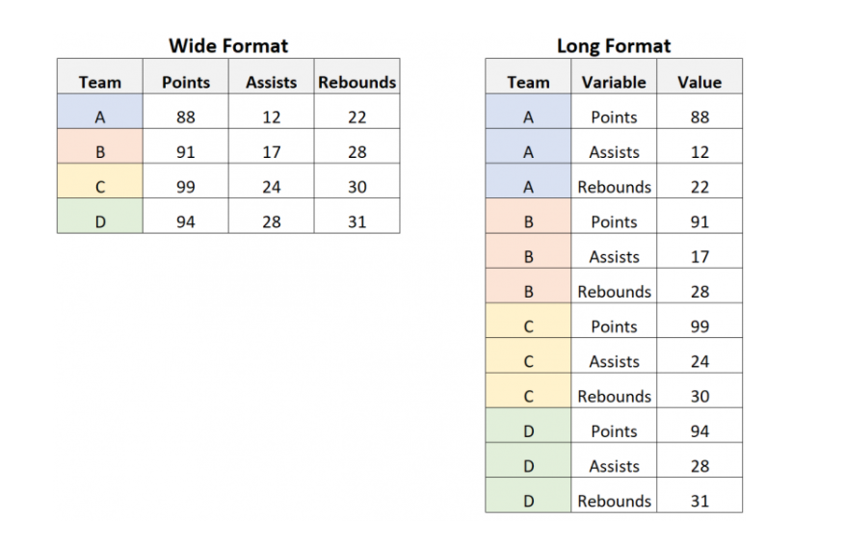
Wide vs. Long Format Data

Slide 14
Examples of data frames in serology
Sample meta-data
Unique sample ID
Sample date*
Specimen information (DBS, plasma)
Manual flag for sample quality
Demographics*: age, sex, geo location, vax status
Survey indicators*: sample weight
(*may store separately)
Manual flag for whether the sample is included in the data analysis
Control meta-data
Unique control ID
Whether it’s a positive vs. negative control, and for which antigen(s) (e.g., “US non-traveler who’s never had Pf malaria”)
Dilution, if part of a standard curve (e.g., “Positive Pool 1:50”)
Short description of what the control is (e.g., “NIBSC XX international standard”)
Experiment meta-data
Plate ID
Date run
Unique sample ID
Well ID
MFI (by antigen)
Net MFI (by antigen)
Bead count (by antigen)
Typically, a wide dataset with each antigen-specific MFI as a column
Notes:
Some other things to be added to consider adding to the sample meta data: (genomic literature note these can be encoded as NA) host species (e.g. other non-human serology), geographical location name, lat long
Some things that can be added to experimental meta data: some other things can also be NA: bead region antigen specific info or control type e.g. GST or blank bead etc. , antigen pathogen, antigen name, antien provenance (commercial, lab that made it etc.), tags

Slide 15
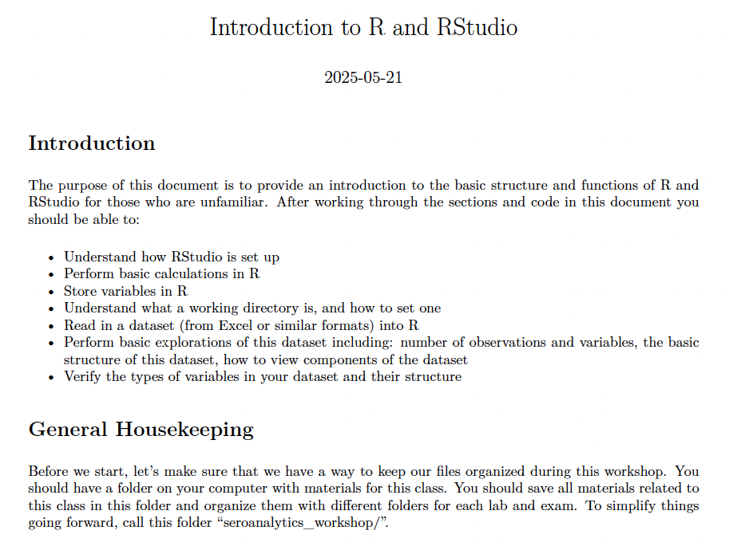
Follow along in the Intro to R.Rmd and Intro to R.pdf files

